Slide 1
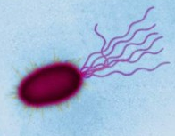
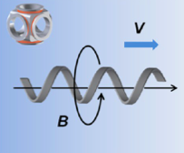
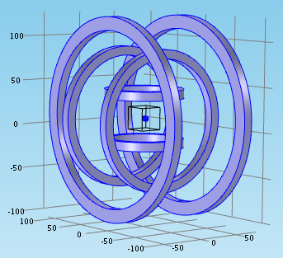
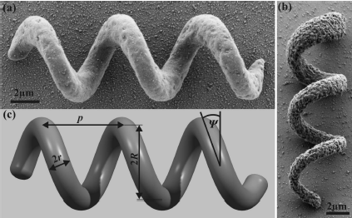
Platform for Microrobot Navigation
Nafiseh Vahabi
MRes

Slide 2
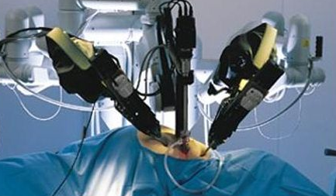
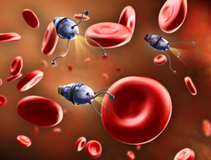
Motivation
Benefit of robotic surgery over invasive surgery
Shorter hospitalization
Reduced pain and discomfort
Minimal scarring
Miniaturization
Cardiovascular surgery

Slide 3
History of Swimming Microrobot
At 1930 (Bruce) first swimming mechanism at micro scale
Bell 2007 first Artificial Bacteria Flagellum
Zhang 2009, characterized them
Mahoney et al. 2012, velocity control
Nelson et al. 2013, actuation and fabrication

Slide 4
Potential Application
application divided into two categories:
Biomedical In vivo
Minimally invasive procedures
Targeted drag delivery
Ablation of the material
Delivery of hyperthermia for cancer treatment
In vitro (lab-on-a-chip)
Manipulation and characterization of cells
Microfluidic control
Most of these applications placed micro-device into fluidic or soft environment.

Slide 5
Key Challenges
Design a helical microrobot and characterization
Evaluation of nano printed structures
Analysis of locomotion swimming helical microrobot in high viscous fluid
Analysis of magnetically actuated helix
Try simulator packages,

Slide 6
Project Overview
Simulation
Propulsion Algorithm
Actuation Algorithm
Design
Optimization
Validation
Fabrication
Nanoscribe
SEM

Slide 7
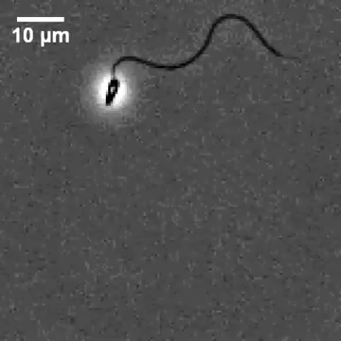
Design
Why helical shape?
Non-reciprocal configuration
Net motion
Helix has a same angle of
attack to the direction of motion

Slide 8
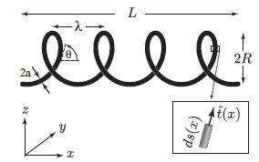
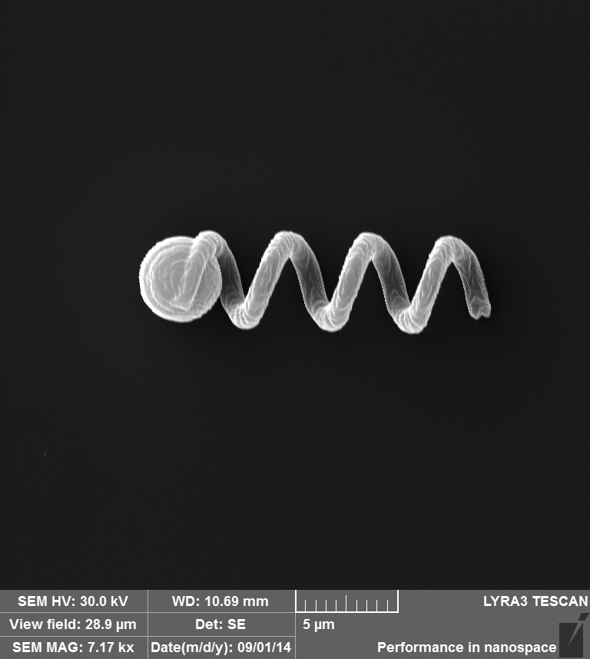
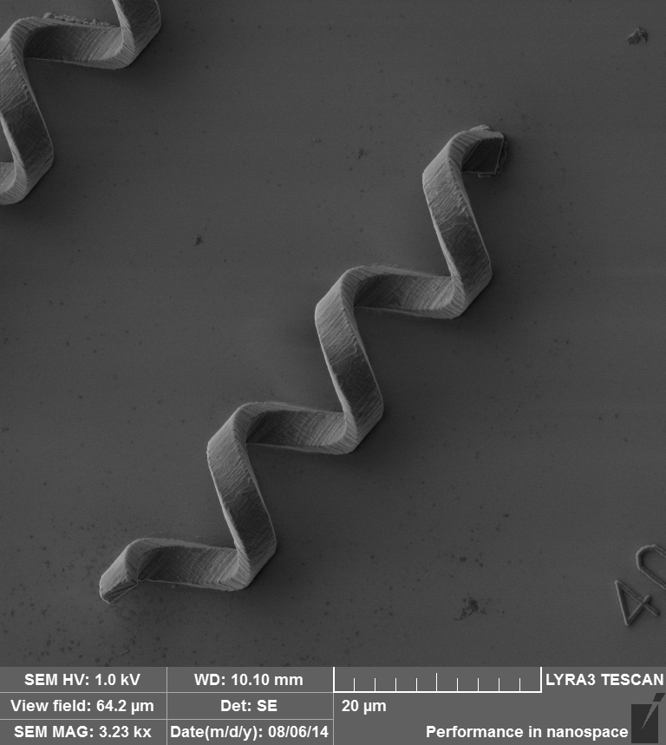
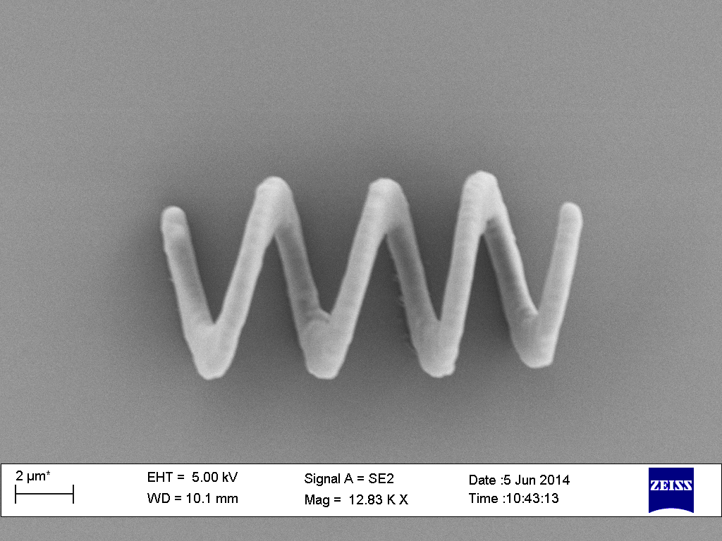
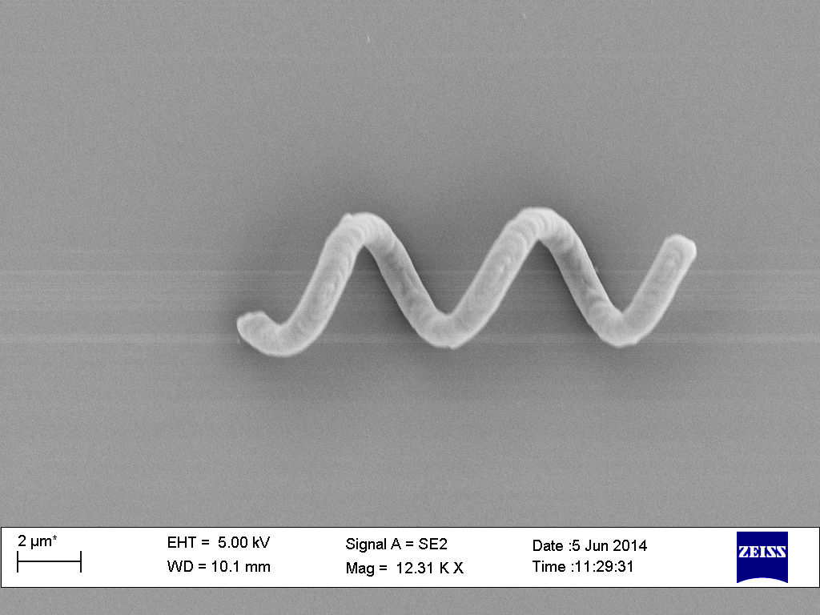
Design
Helix key parameters
Helix length
Pitch
Pitch angle
Helix radius
Filament radius

Slide 9
Simulation
Propulsion
Algorithm
Desired
Velocity
Actuation
Algorithm
RFT
RSM
BST
Electric
Current
Magnetic
Field
Torque

Slide 10
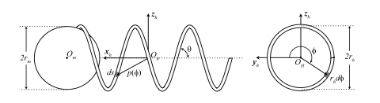
Propulsion Modeling
Resistive Force Theory (RFT)
Decomposes the velocity vector
Relate them to drag force
Define the coordinate frame for helix
Rotate from segment frame to helix frame
Express the differential relating velocity to force in three dimension
Velocity of segment decomposes to the sum of rotational and translational velocity

Slide 11
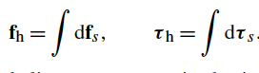
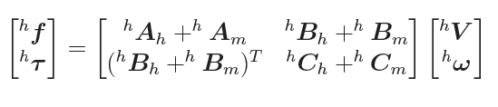
Resistive Force Theory
Relating fluidic force and torque to the translational and rotational velocity

Slide 12
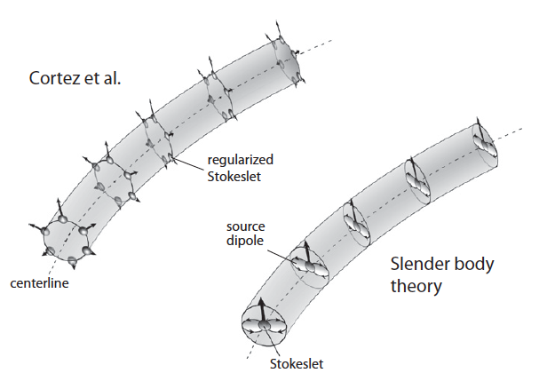
Propulsion Modeling
Regular Stokeslet Methods (RSM)
Discretizes the surface of helix filament
Represent each surface
element by regularized
stokeslet.
Body Slender Theory (BST)
Using stokeslet and
doublets arranged along the
Helical centre line.

Slide 13
Actuation
Applied magnetic field
To compensate the drift caused by the weight
Direction that it must point
Rotational velocity
Find the desired velocity from propulsion equations system
Convert the velocity from helix frame to the world frame
Decompose the velocity to vertical and horizantal vectors

Slide 14
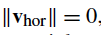
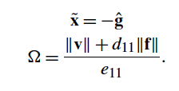
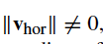
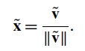
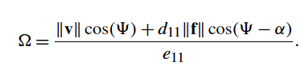
Actuation
If
If

Slide 15
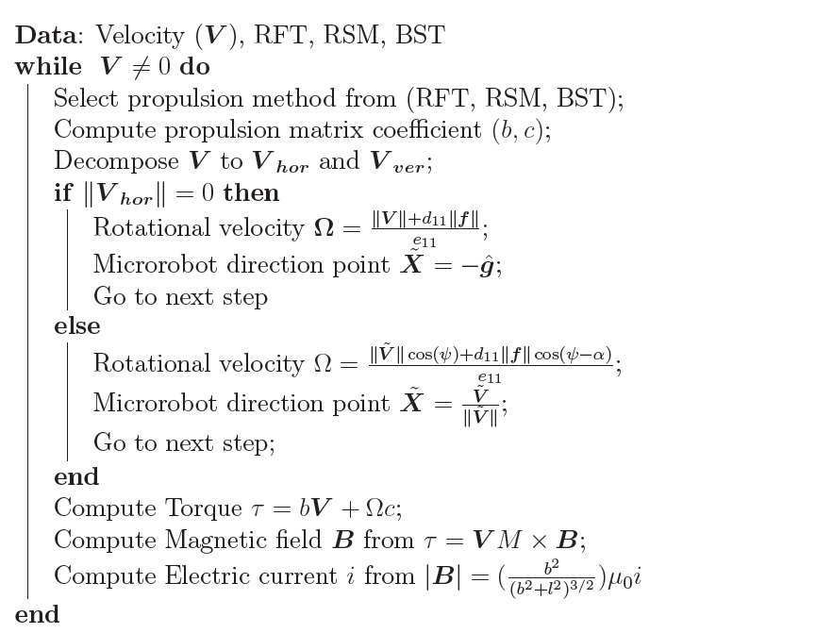
Simulation Algorithm

Slide 16
Fabrication
Nanoscribe
Preparing
Production
SEM
Post-processing
Sputter Coating
Image Analysis
Coating
Magnetic
Material

Slide 17
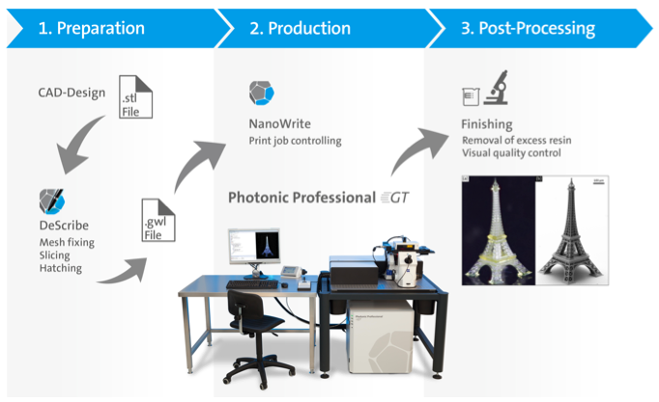
Nanoscribe

Slide 18
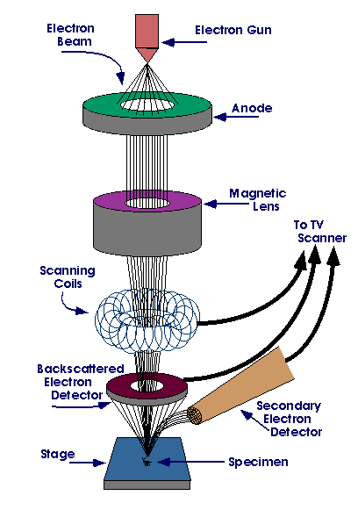
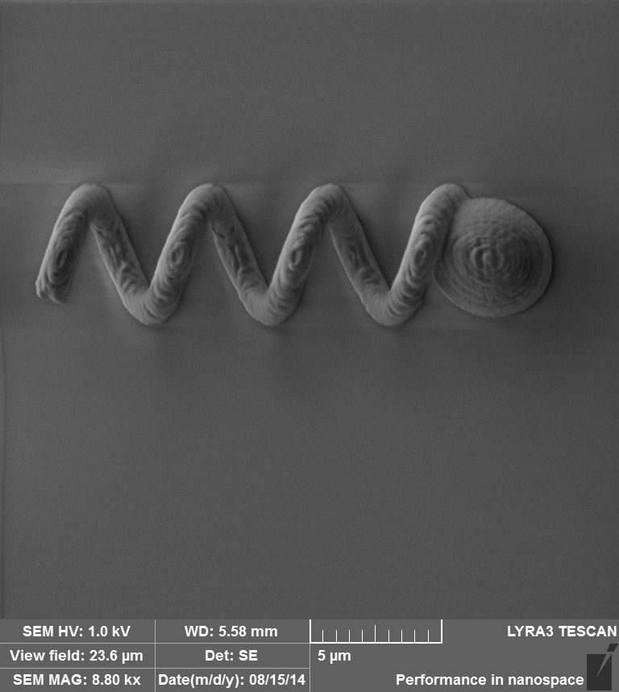
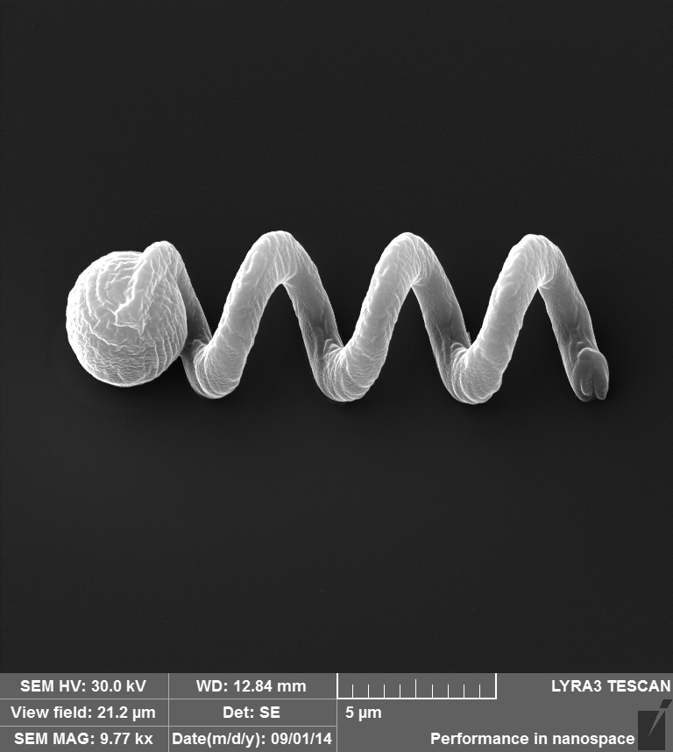
Scanning Electron Microscope
Sputter Coating

Slide 19
Results
Simulation results
Simulation framework
Linear relationship between rotational and translational velocity
Linear relationship between translational velocity and electric current
Design result
Variable pitch helical design
Fabrication results
Fabricating different design of microrobot

Slide 20
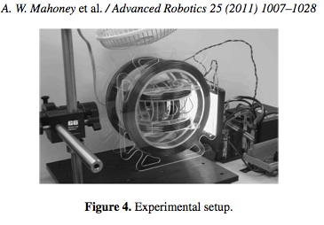
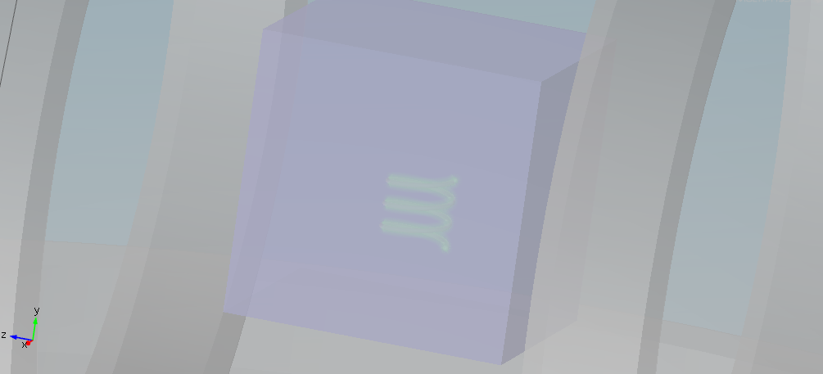
Simulation Result

Slide 21
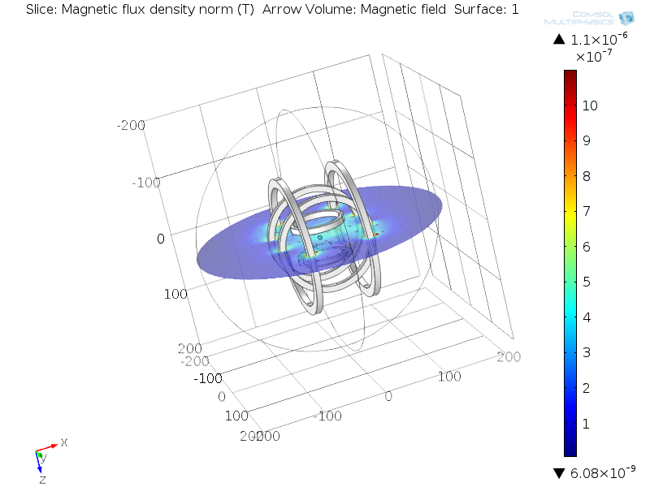
Simulation Result

Slide 22
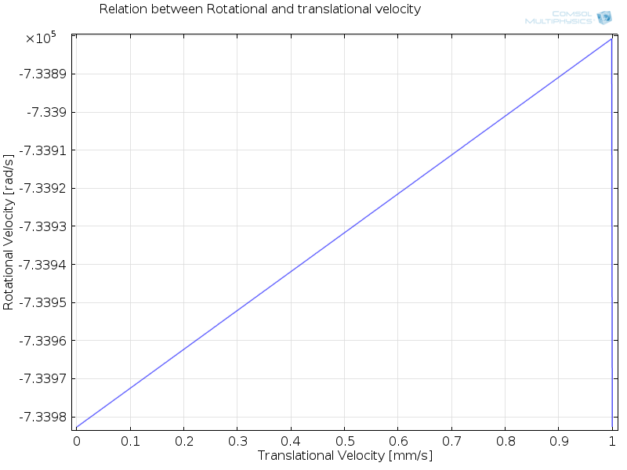
Simulation Result

Slide 23
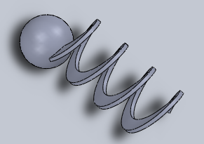
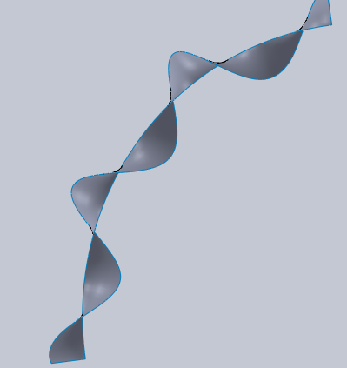
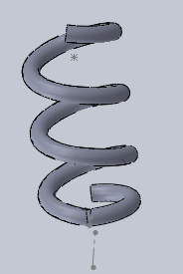
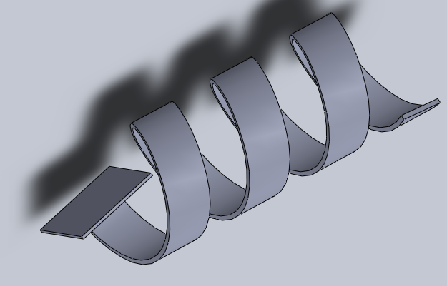
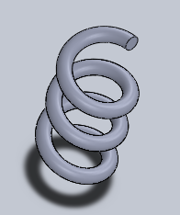
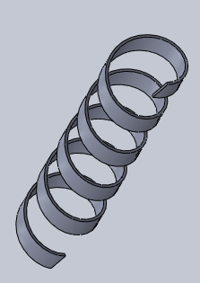
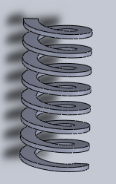
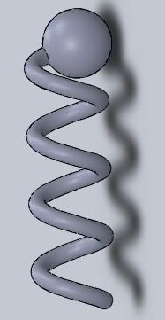
Design Results
- Helix with the variable pitch
- Capable to add propellers

Slide 24
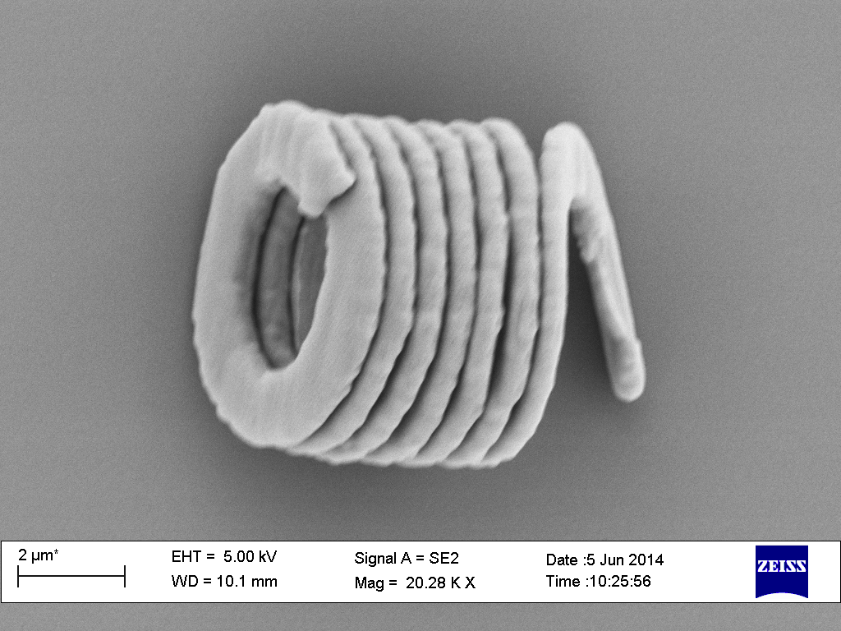
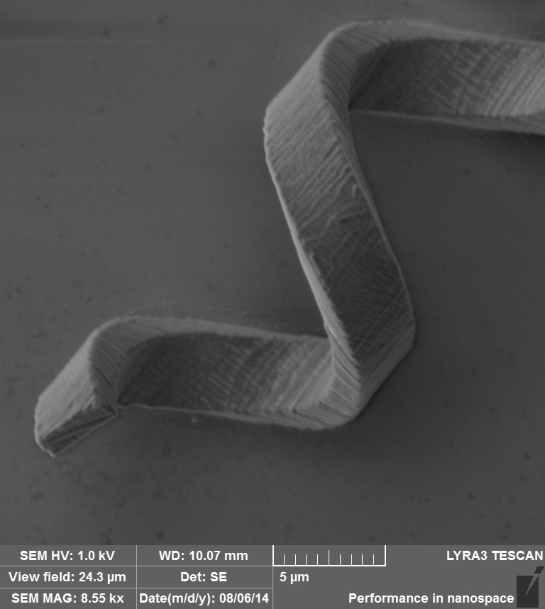
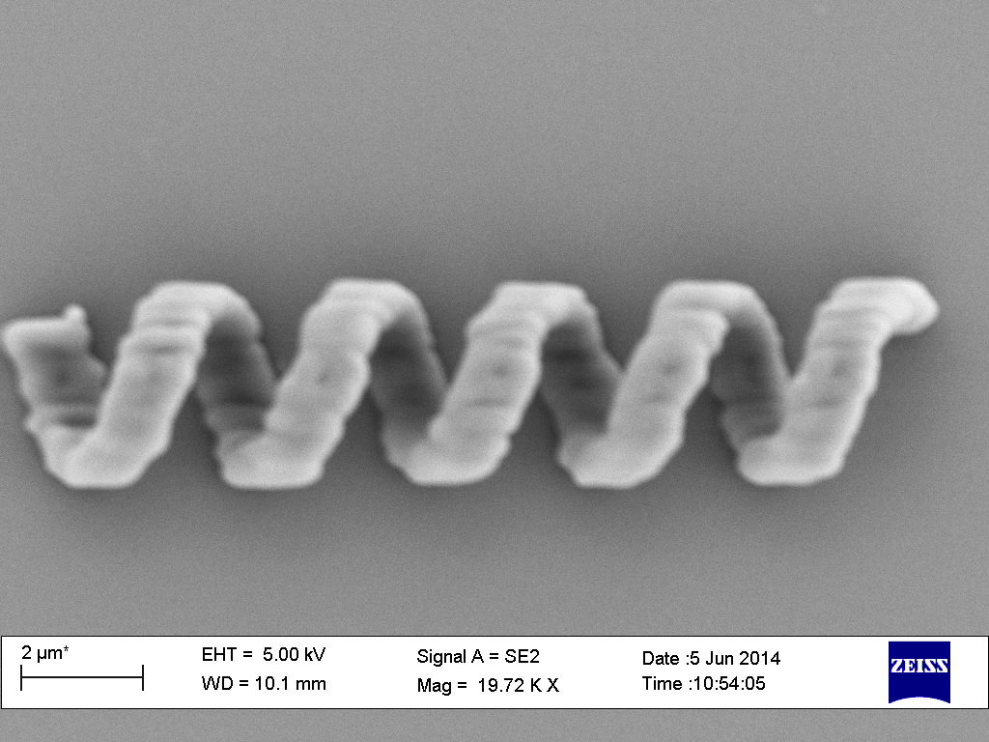
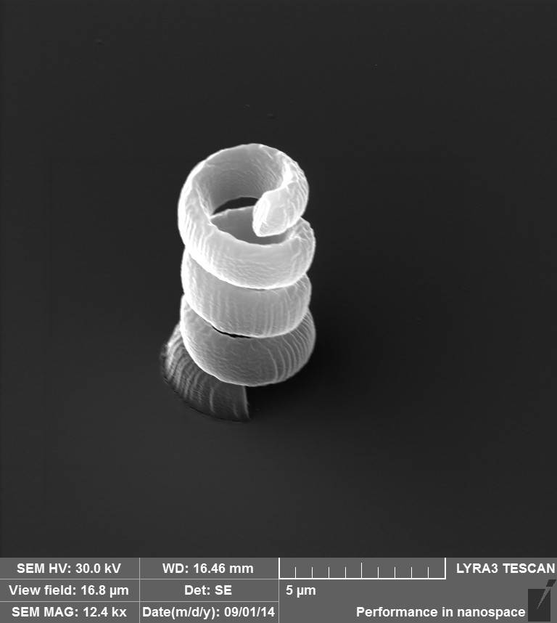
Fabrication Result

Slide 25
My Contribution
The helix design with a variable pitch
The first application of Regularized Stokeslet Method and Body
Slender Theory in remotely controlled swimming microrobot to model the propulsion of the microrobot in high viscous fluid.

Slide 26
Conclusion
Mathematics model to find electric current from microrobot velocity is solved
New design of microrobot to satisfy fabrication requirement
Helix propulsion methods for remotely controlled microrobot
Basic framework for microrobot simulation
Future work
Optimizing simulation platform
Applying new actuation method such as ultrasonic
Designing propeller with the helix tail
Validation

Slide 27
Thank you for your attention Thanks to my supervisors Prof. Guang-Zhong Yang Dr. Vincenzo Curto Dr. Henry Ip

